Slide 1










Multilingual Summarization
Kathy McKeown
Yanda Chen
Chris Kedzie
Suraj Nair
Petra Galuščáková
Rui Zhang
Doug Oard
Faisal Ladhak
Esin Durmus
Claire Cardie
Funded in part by IARPA Material

Slide 2
A key issue: Data

Slide 3


Summarization Tasks
Query focused summarization
Given a query, generate a summary of an article that highlights information relevant to the query Chen et al, Cross-language Sentence Selection via Data Augmentation and Rationale Training, ACL 2021
Abstractive summarization
Summary contains generated sentences that may or may not contain phrases from the input article
Ladhak et al, WikiLingua: A New Benchmark Dataset for Cross-Lingual Abstractive Summarization, EMNLP 2021

Slide 4
Data
Summarization: Need paired articles and summaries
Articles or summaries in multiple languages (article in source language, summary in English)
Query-focused Summarization needs even more: paired queries, articles and query-focused summaries
For low resource languages even more challenging
Our approach: synthetic and distantly labeled data

Slide 5
Query-focused summarization
Cross-language search and summarization for low resource languages
Summarization takes as input a foreign-language document retrieved by cross-lingual IR and presents information from the document (a sentence) in English for an end user to determine relevance
Extractive summarization: Looking for sentences relevant to query
Somali, Swahili, Tagalog
Queries: single words and phrases
Need a relevance dataset where for each English query and foreign language sentence in documents, we have a relevance label of {0,1}

Slide 10
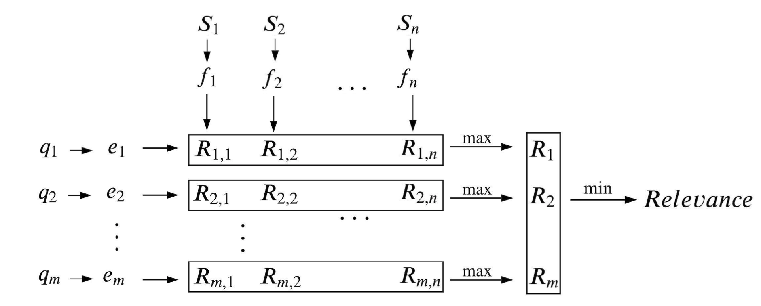
SECLR – Supervised Embedding-based Cross-Lingual Relevance Model
Given a sentence S, a unigram query q, and an embedding matrix W:
p( y=relevant | q, S) = σ( max_{s ∈ S} w_{s}^{T} w_{q} )
Learned by minimizing cross-entropy for the relevance task:
L_rel = − log p(r|q, S; W)

Slide 11
Alignment Issues
Ideally, s* = arg max_{s ∈ S} w_{s}^{T} w_{q}
would correspond to genuine translation equivalents s* and q.
Example: (in practice) S = sandwich de crema de cacahuate con mermelada q = jelly s* = mermelada cacahuate

Slide 12
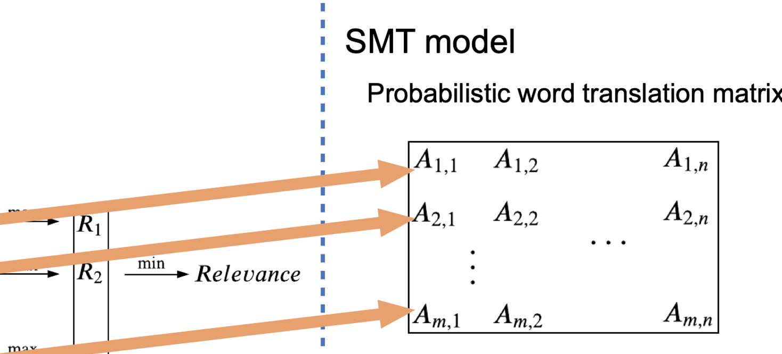
SECLR-RT – Augmented with Rationale Training
Statistical MT (SMT) learns more precise alignments of query/sentence
Intuition: Regularize SECLR behavior with SMT’s “rationales” (alignments)

Slide 13
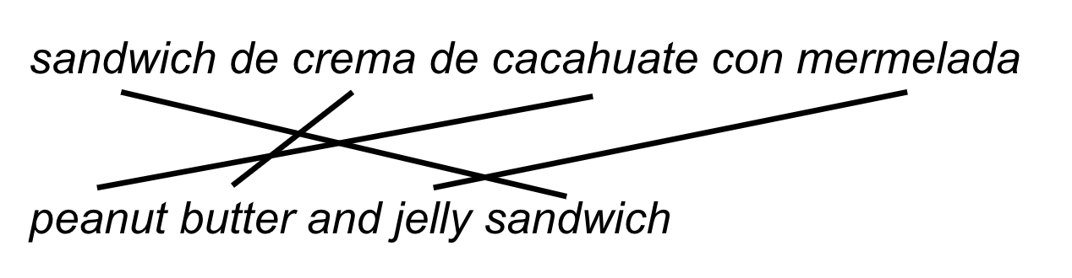

SECLR-RT – Augmented with Rationale Training
Statistical MT (SMT) learns more precise alignments of query/sentence
Intuition: Regularize SECLR behavior with SMT’s “rationales” (alignments)

Slide 15
Abstractive Summarization
Distant learning approach -> WikiLingua
Summary/article pairs drawn from WikiHow, a how-to guide
18 languages
Each summary/article written and edited by 23 people
Further reviewed by an additional 16 people
Each step consists of a summary followed by paragraph detailing instructions
Develop direct cross-lingual summarization approach on this data

Slide 16
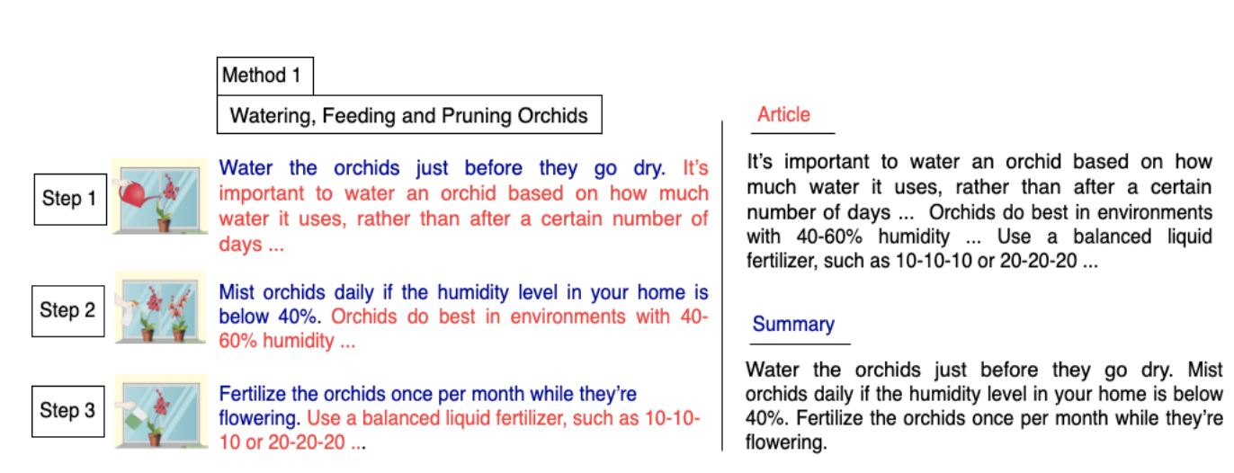
Summary/article construction

Slide 17
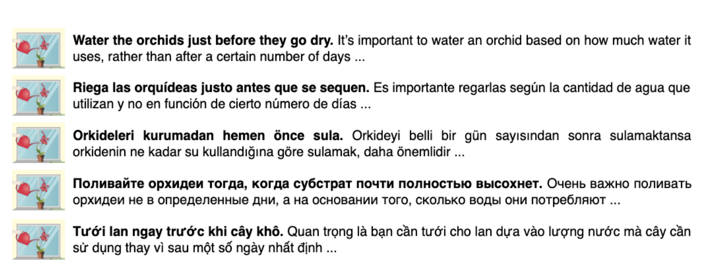
Aligning Across Languages

Slide 18
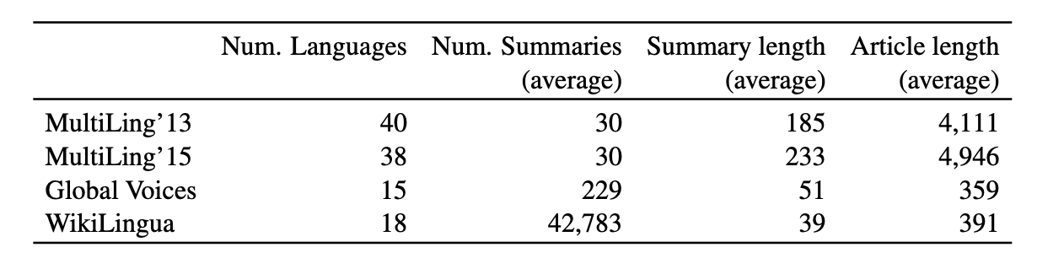
Data Statistics

Slide 19
Enables Experimentation with a Variety of Models
Traditional models
Summarize then Translate (SumTrans)
Translate then Summarize (TransSum)
Translate then Summarize augmented with round-trip translation (TransSum-R) (Ouyang et al 2019)
New models to avoid translation at summarization time
Direct Cross-lingual summarization (DC) – mBART tuned with source language articles and English summaries
Direct Cross-lingual summarization with synthetic data (DC + Synth) – augmented with English articles translated to source paired with English summaries
Direct Cross-lingual summarization with synthetic data and MT – mBART fine-tuned for MT followed by fine-tuning for summarization

Slide 20
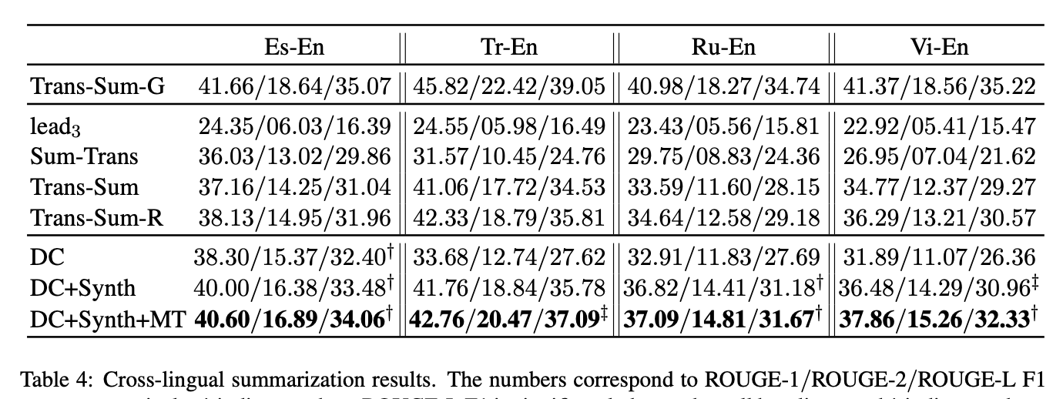
Article: Does the speaker talk in a way that makes you want to keep listening, or is it easy to tune out? ... The way the speaker holds him or herself should project confidence and charisma, making the audience feel engaged and included ... Too many “ums”, “likes” and “uhs” take away from a speaker’s credibility ... A great speaker should have memorized the speech long in advance ... Look for signs that the speaker is nervous so you can offer a critique that will help him or her improve next time ...
Gold: Listen to the speaker’s voice inflections. Watch the speaker’s body language. Listen for filler words. See if the speech was memorized. Assess how the speaker manages anxiety.
Trans-Sum: Keep the listener’s attention. Maintain good posture. Memorize speech beforehand. Identify signs of nervousness.
DC+Synth+MT: Pay attention to the way the speaker is speaking. Notice the way the speaker uses body language. Keep track of the words they say. Remember what they have to say. Watch for signs of nervousness.

Slide 21
Conclusions and Open Questions
With synthetic and distantly labeled data, we can learn about model quality for multilingual summarization
What about
Few-shot learning, In-context learning, Prompting?
Our initial work suggests these techniques do not work well for summarization given size of examples, but more exploration needed
Can we get to a point where data is not the major issue? Or will high quality data always be an interesting and creative research approach for multilingual tasks?

